Slide 1

Introduction to complex trait genetics
Eleftheria Zeggini
Human Genetics
Wellcome Trust Sanger Institute
eleftheria@sanger.ac.uk

Slide 2
Complex diseases
Genes
Environment

Slide 3
Genes vs environment
Infectious disease
Environment
Osteoarthritis
Type 2 diabetes
Monogenic
Genes

Slide 4
Genetic architecture of complex traits
Common variants
Rare variants
Small effect size
Large effect size

Slide 5

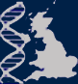


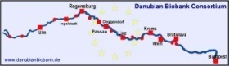

Large sample collections

Slide 6
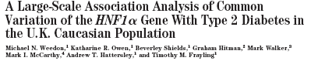
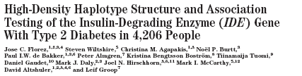


Large sample collections
Understanding of patterns of human genome sequence variation
Notes:
6

Slide 7
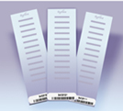
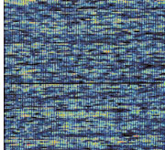
Large sample collections
Understanding of patterns of human genome sequence variation
High-throughput technologies for genotyping
Notes:
7

Slide 8
Principles
Case-control pairs (or population cohorts)
Type for 500k-2.5M SNPs
Obtain information about strength of association
genome wide (within limits of sample size, allele frequency, LD etc)
Follow-up what looks interesting

Slide 9
Association between genetic variants and disease
Cases
Controls
25%
15%

Slide 10
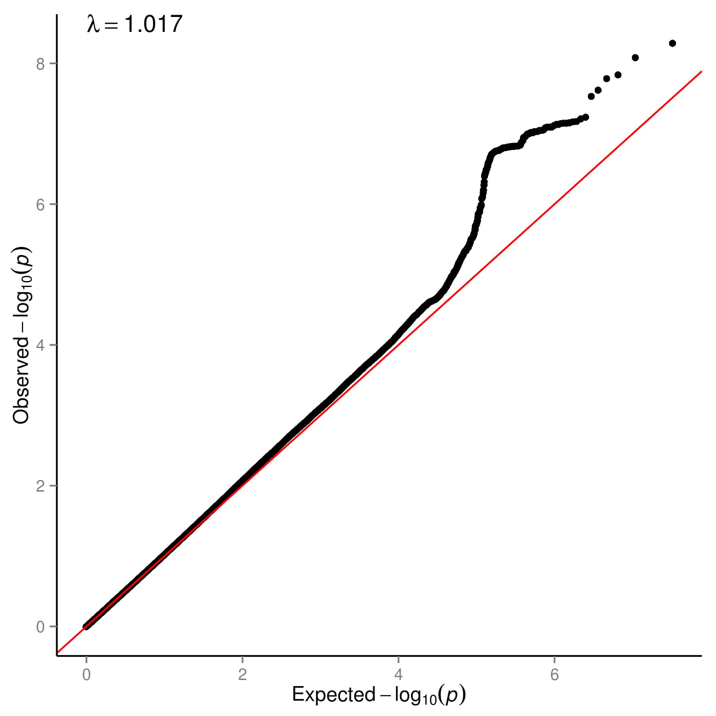

Slide 11
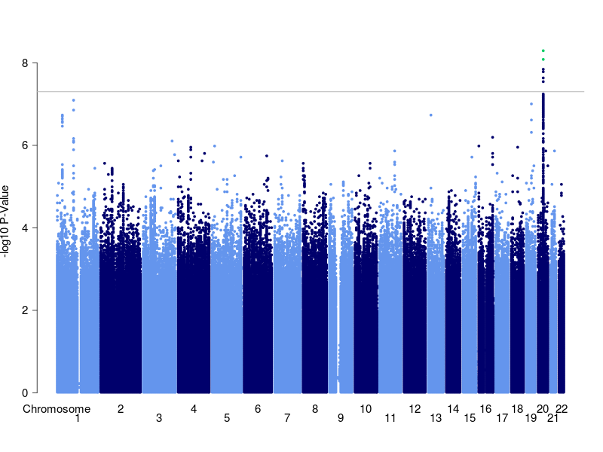

Slide 12
Sample size matters
Power to detect association (p=5x10⁻⁸) at a variant with risk allele frequency 0.30 and allelic OR 1.10
Notes:
12

Slide 13
Power to detect association (p=5x10⁻⁸) at a variant with risk allele frequency 0.005 and allelic OR 1.50
Notes:
13

Slide 14
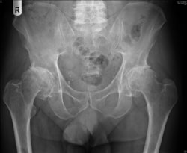
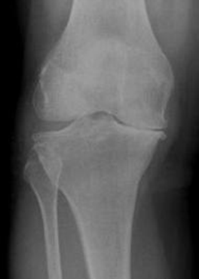
Osteoarthritis
Osteoarthritis (OA) is characterised by cartilage degeneration in the joints leading to pain and loss of function
50% of people over the age of 70 years
No curative therapy: analgesics, total joint replacement

Slide 15
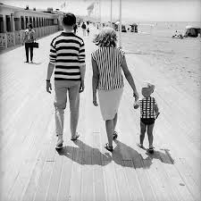
Heritability of OA
~50%: half of the variation in susceptibility to OA in the population is due to genetic factors

Slide 16
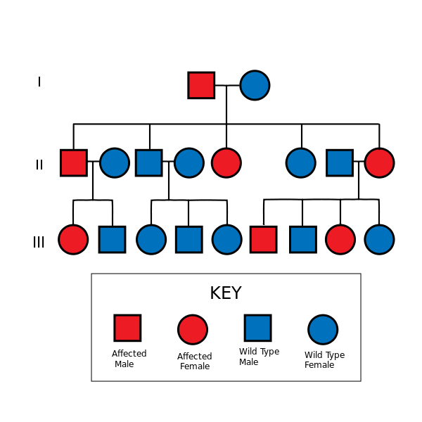
OA is not a single gene disorder

Slide 17
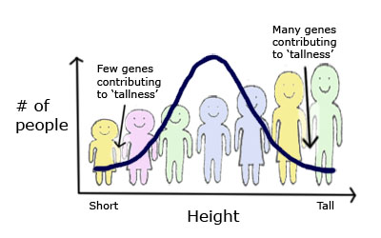
OA is a complex or polygenic disease
Many genes contributing to OA
Few genes contributing to OA
Number
of
people
Low risk of developing OA
High risk of developing OA

Slide 18

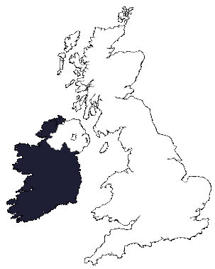
arcOGEN Consortium arc Osteoarthritis Genetics
11 participating sites:
Edinburgh
Northumberland
Newcastle
Manchester
Sheffield
Nottingham
Worcester
Cambridge
Oxford
London
Southampton

Slide 19
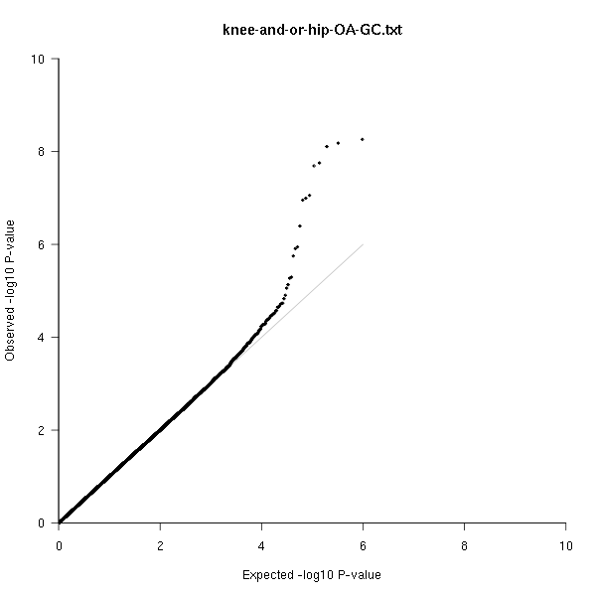
7,410 OA cases v. 11,009 controls

Slide 20
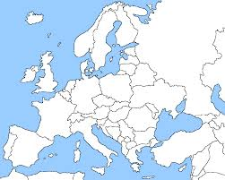
Replication Replication Replication
Combined analysis
14,883 cases and 55,775 controls

Slide 21
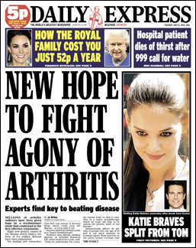
arcOGEN finds 9 new OA risk variants
Zeggini et al, Lancet, 2012

Slide 22
Replicating signals
SNP | Chr | Nearest gene(s) | Effect Allele Freq (controls) | OR [95% CIs] | P
rs6976 | 3 | GLT8D1 | 0.37 | 1.12 [1.08-1.16] | 7.24E-11
rs4836732 | 9 | ASTN2 | 0.47 | 1.20 [1.13-1.27] | 6.11E-10
rs9350591 | 6 | FILIP1, SENP6 | 0.11 | 1.18 [1.12-1.25] | 2.42E-09
rs10492367 | 12 | KLHDC5, PTHLH | 0.19 | 1.14 [1.09-1.20] | 1.48E-08
rs835487 | 12 | CHST11 | 0.34 | 1.13 [1.09-1.18] | 1.64E-08
rs11842874 | 13 | MCF2L | 0.07 | 1.17 [1.11-1.23] | 2.07E-08
rs12107036 | 3 | TP63 | 0.48 | 1.21 [1.13-1.29] | 6.71E-08
rs8044769 | 16 | FTO | 0.50 | 1.11 [1.07-1.15] | 6.85E-08
rs10948172 | 6 | SUPT3H | 0.29 | 1.14 [1.09-1.20] | 7.92E-08

Slide 23
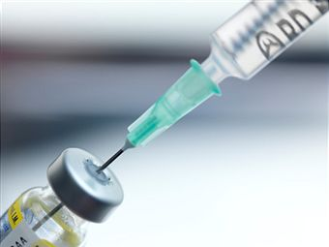

Potentially interesting targets
Carbohydrate sulfotransferase 11 gene, CHST11, affects cartilage proteoglycan
Nutraceutical compounds like chondroitin sulfate have been studied with contradictory results
Parathyroid hormone-like hormone gene, PTHLH, is the basis for parathyroid hormone-based treatments for osteoporosis
These compounds may also be effective in osteoarthritis

Slide 24
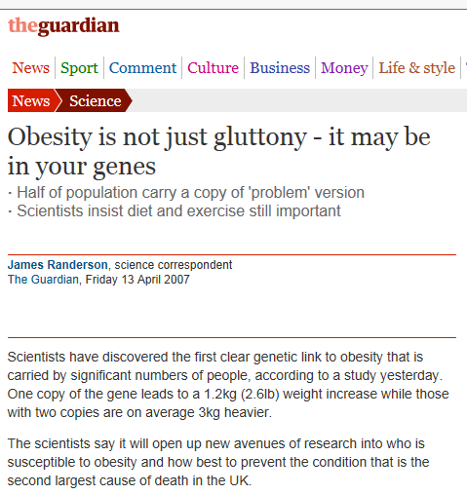
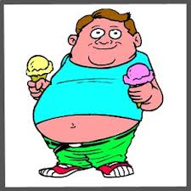
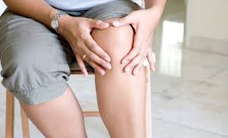
Fat mass and obesity-associated gene
http://www.nairaland.com/965900/what-obesity
FTO exerts its effect on OA through obesity
Shared genetic determinants of linked diseases

Slide 25
High bone mineral density is correlated with increased risk of OA
Risk of osteoporosis is inversely correlated with risk of OA
Examined genetic overlap between OA and BMD to identify pleiotropic loci
Replication in 23,425 OA cases and 236,814 controls
OA
BMD
SMAD3 plays a role in bone remodeling and cartilage maintenance
Hackinger et al, in press
Notes:
In or out?

Slide 26
Bigger sample size

Slide 27


Harnessing the power of large biomedical resources
Notes:
UKBB ~15k with THR or TKR, ~18k with hip or knee OA

Slide 28
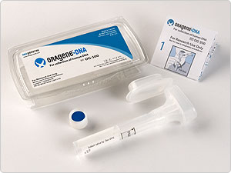
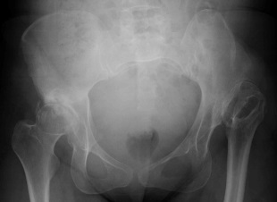
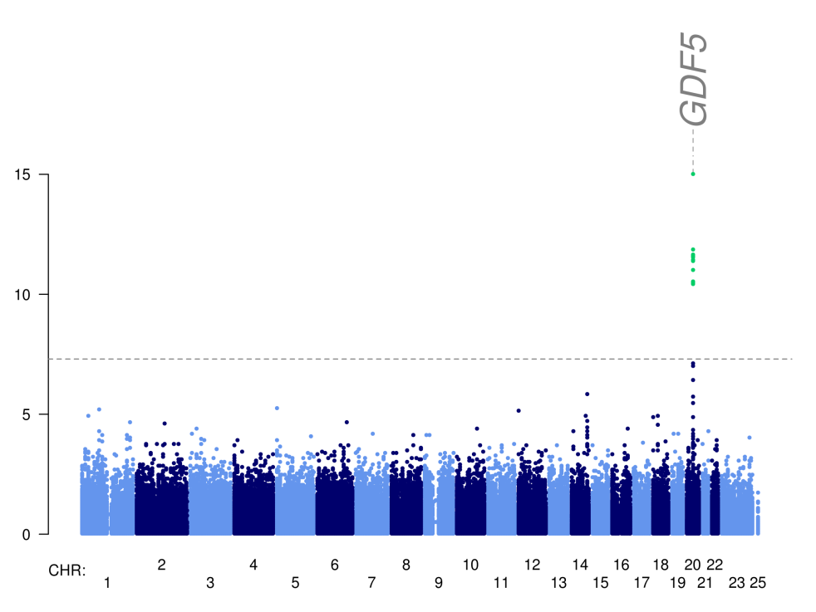
Accessing registry records and patient recruitment
Developmental dysplasia of the hip -National Joint Registry
1,091 postal DNA kits to pre-screened consenting participants
907 returns
Electronic radiographs obtained through Image Exchange Portal
Median yield 138µg
(IQR 64-301)
Notes:
The National Joint Registry is the biggest data repository of joint replacement in the world, with 1.8 million existing records, and accruing new records at 250,000 per annum. We have experience of successfully using the NJR recruitment mechanism to generate a developmental dysplasia of the hip (DDH; prevalence ~1.3 in 1000) biobank, which has now been genome-wide genotyped at the Sanger Institute. We anticipate no issues for the OA collection (a significantly more prevalent disease than DDH affecting 40% of those over 70 yrs), and which uses the same methodology (NRES approval; patient contact, consent and screening through Northgate Information Solutions Ltd; collection of detailed medical questionnaire and postal saliva kit; DNA extraction; genome-wide genotyping; access to electronic radiographs through the IEP).

Slide 30
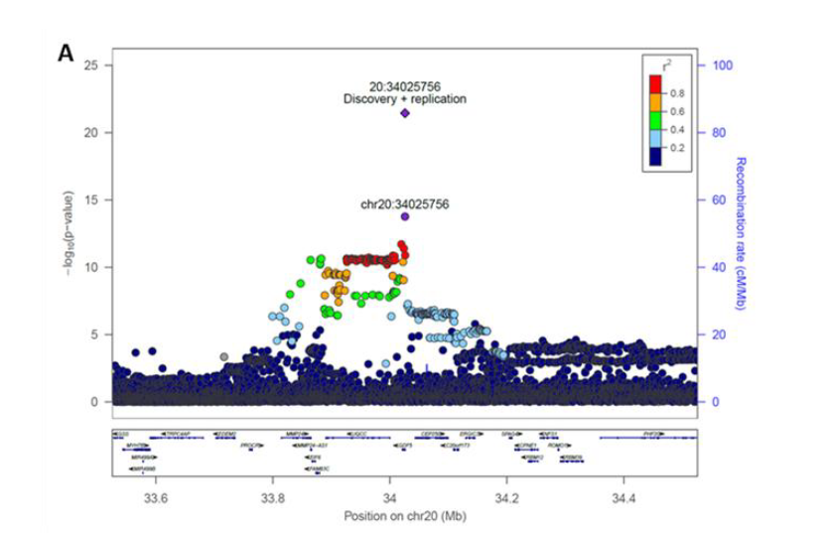
GDF5 is essential for normal bone and joint development
The lead variant is located in the GDF5 promoter and modulates gene expression

Slide 31
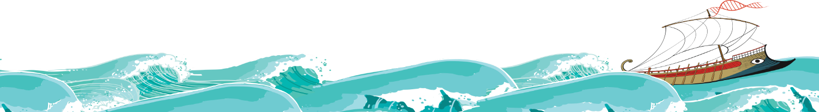
ARGONAUT: Accelerating the discovery of genomics in osteoarthritis through national clinical audit data
25k unicompartmental knee replacement
25k
total knee replacement
Compartmental involvement
Pre-operative scores
Post-operative scores
Complications

Slide 32
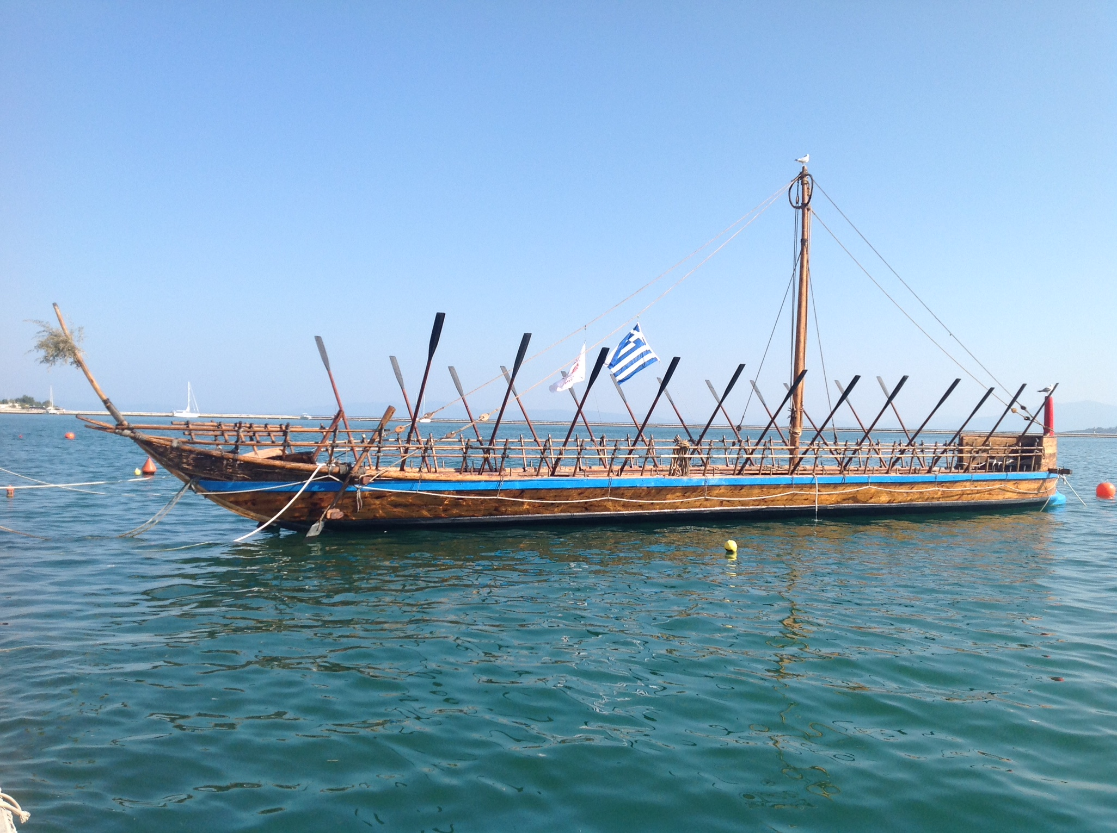

Slide 33
Imputation

Slide 34
Imputation -principles
Reference panel
Analysis sample
chromosomal position
Notes:
34
34

Slide 35
Imputation -principles
Reference panel
Analysis sample
chromosomal position
Notes:
35
35

Slide 36
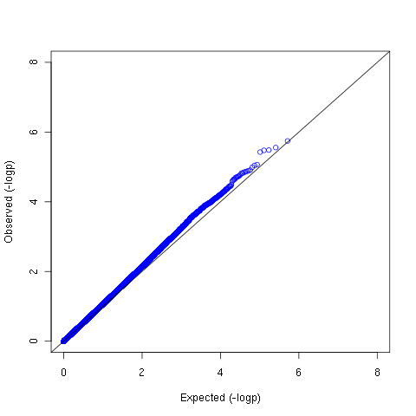
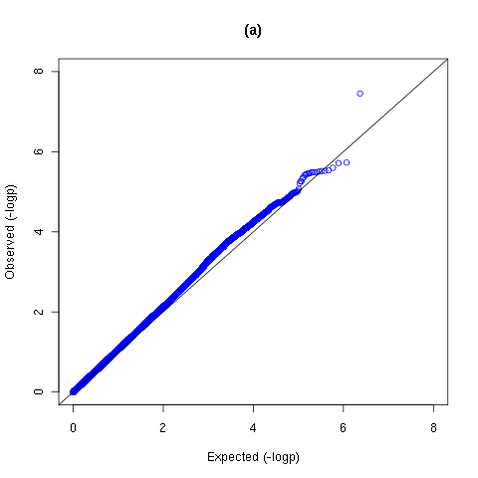
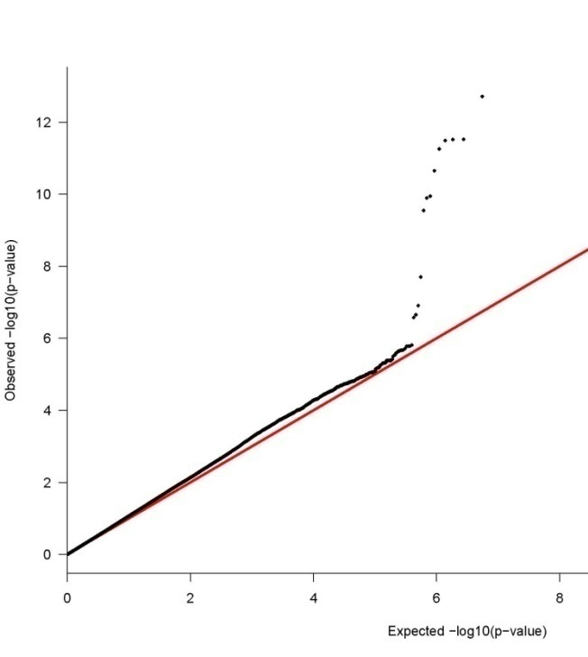
3,177 OA cases
4,854 controls
Directly typed SNPs (Illumina 610k)
Imputed SNPs: HapMap
Imputed SNPs: 1000 genomes

Slide 37
Special populations

Slide 38
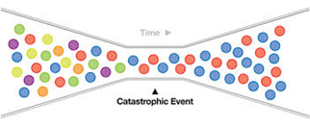

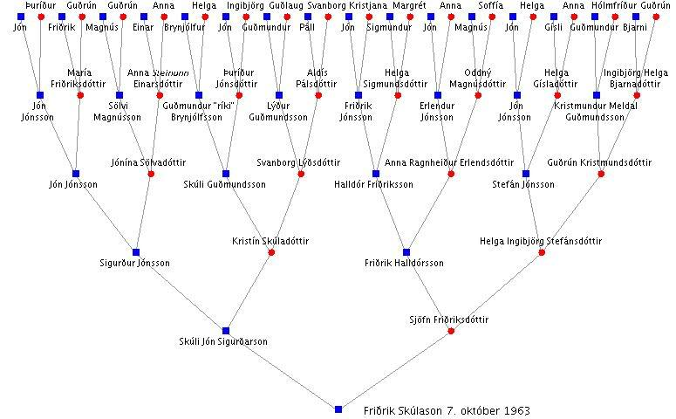
Population isolates
The study of rare variants can be empowered by focusing on isolated populations
Some rare variation is lost, and rare variants may have increased in frequency
linkage disequilibrium tends to be extended
homogeneous environment
better knowledge of population history
Time →
bottleneck event
Notes:
Circles greyed out

Slide 39
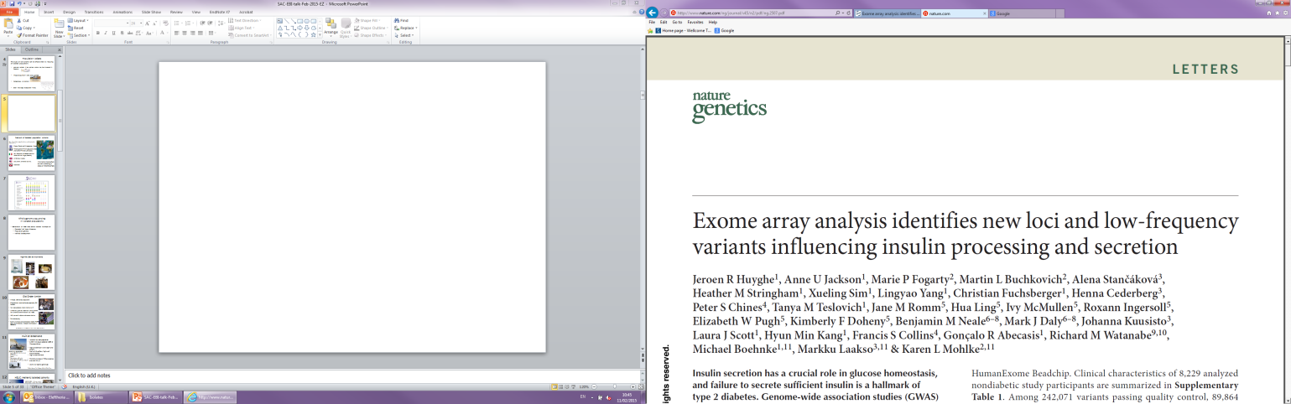
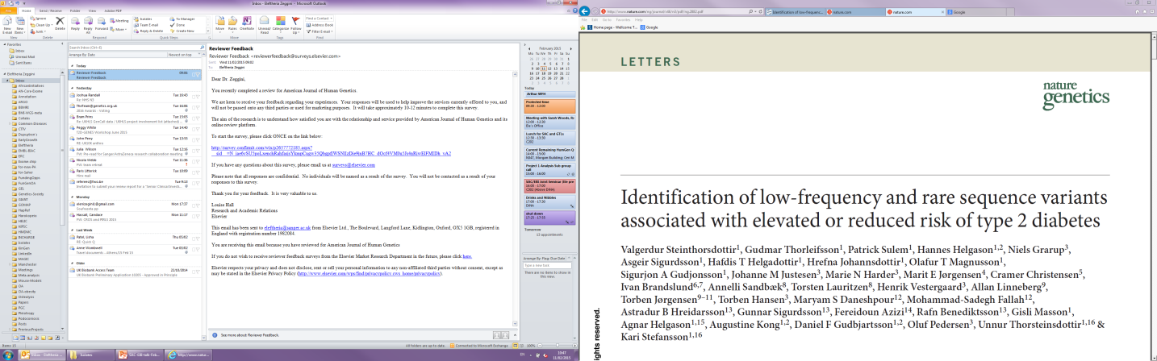
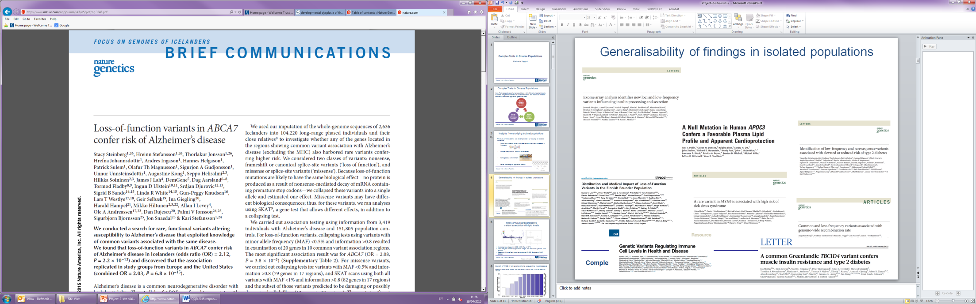
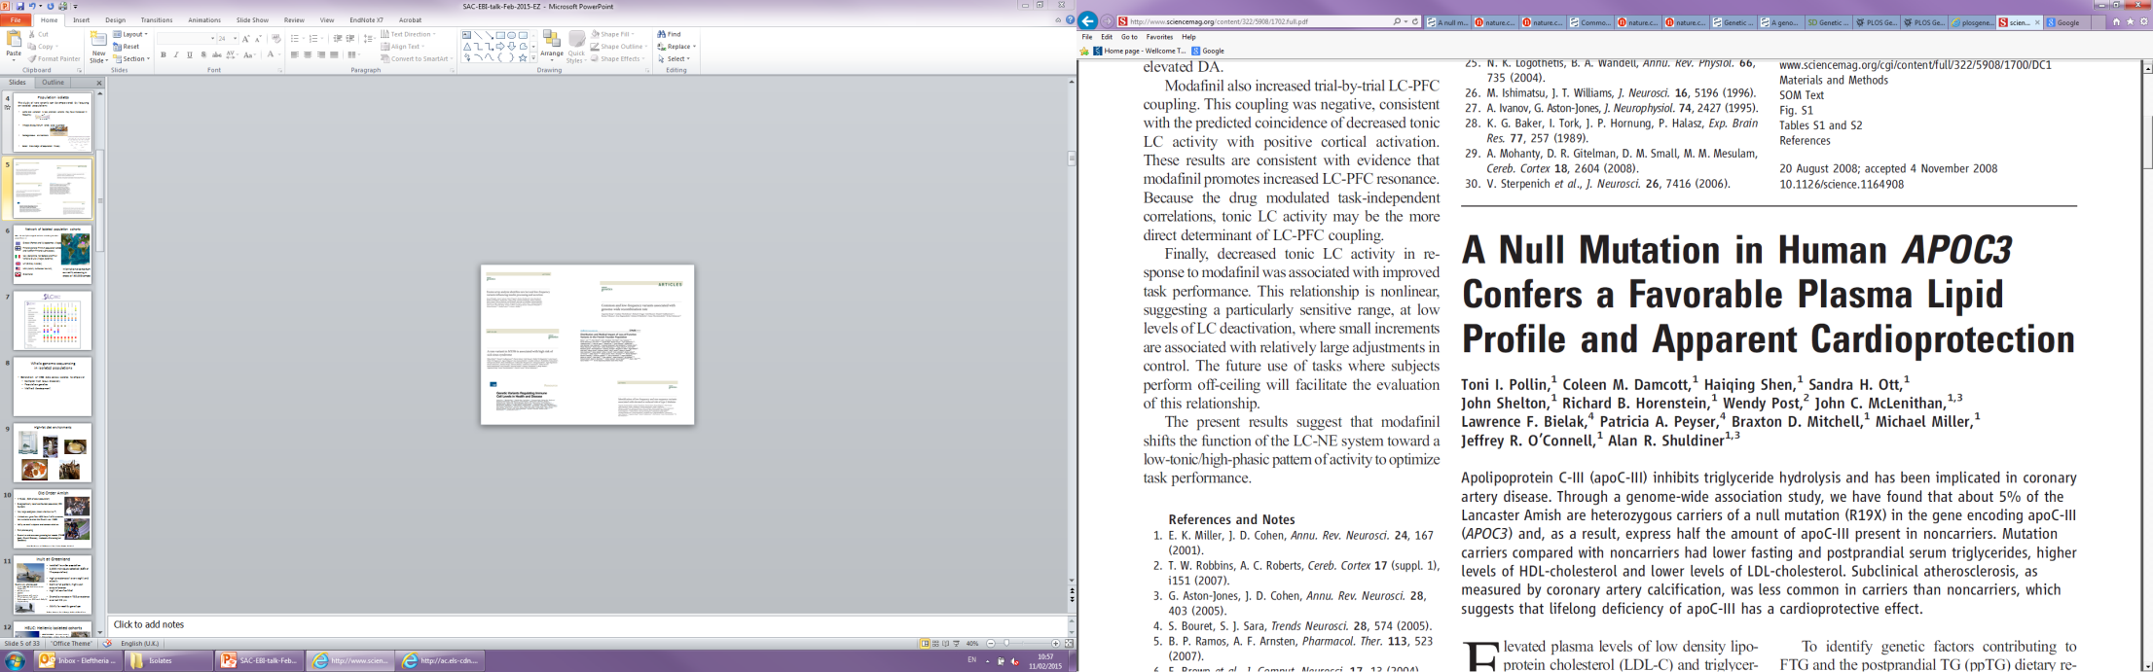
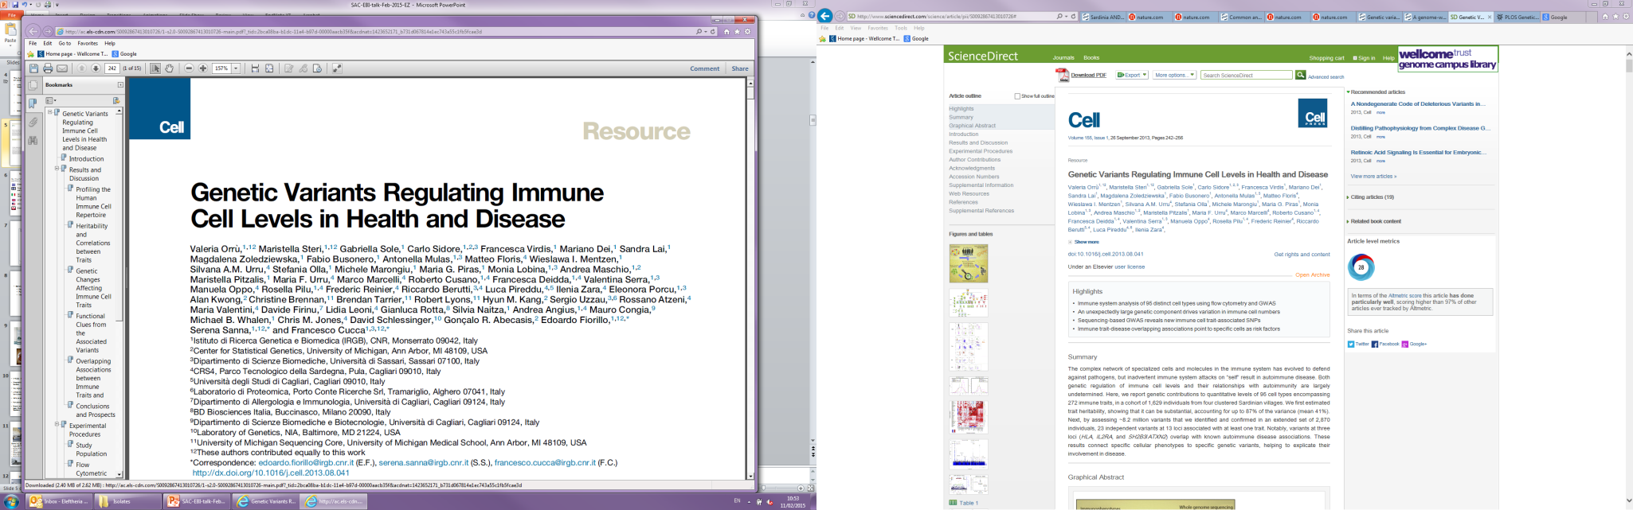
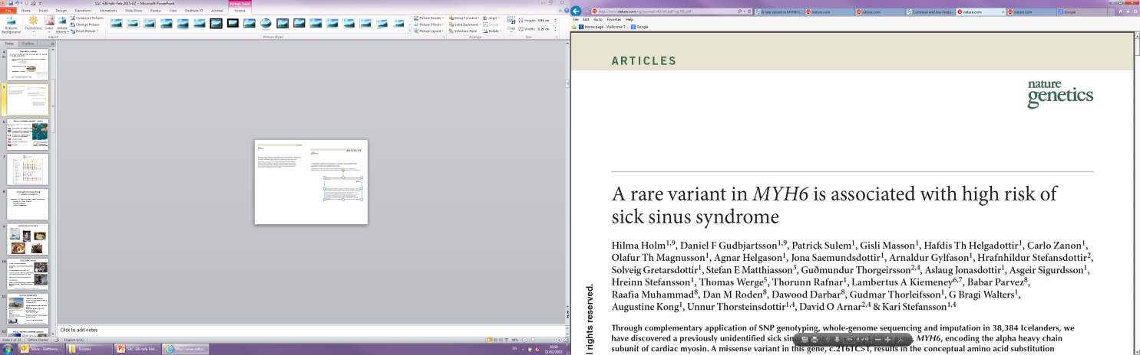
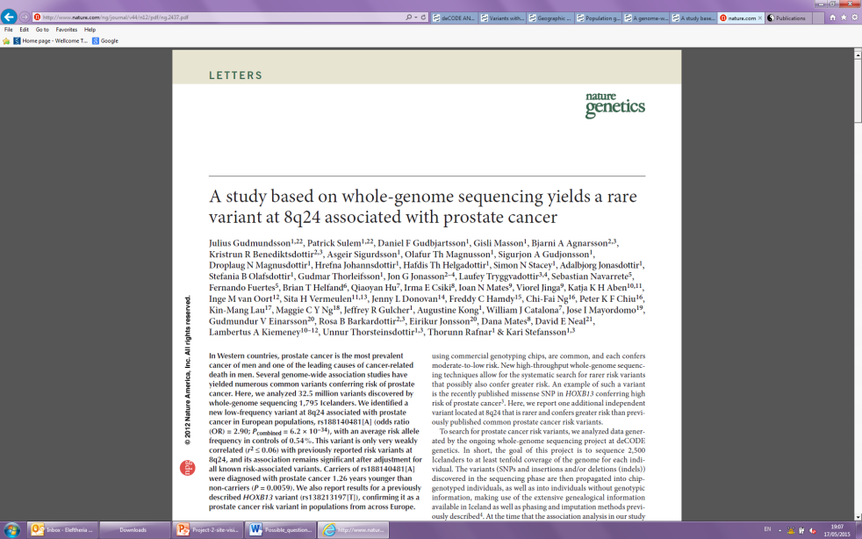
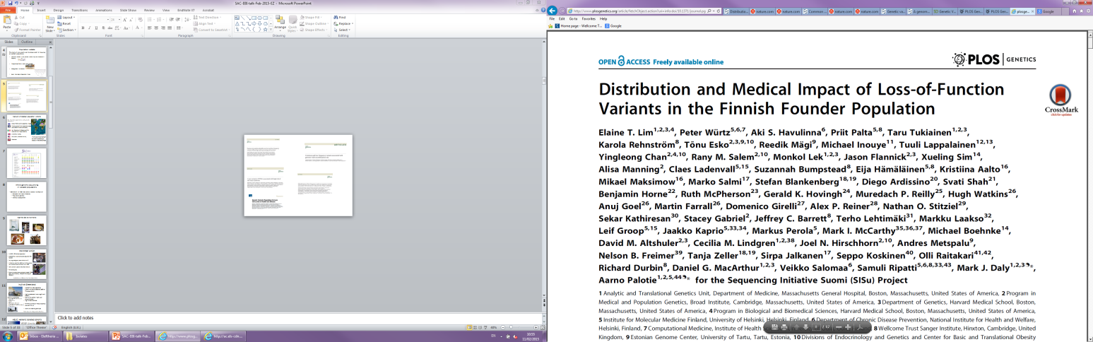
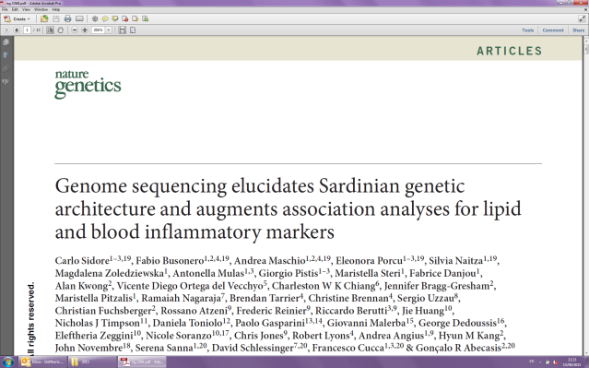
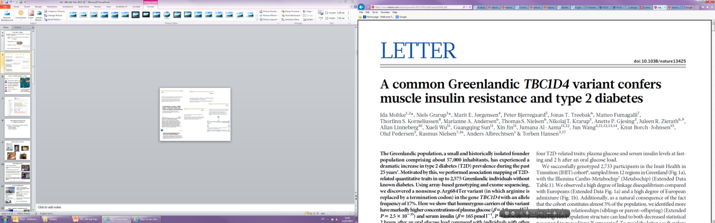
Findings in isolated populations and their wider relevance

Slide 40
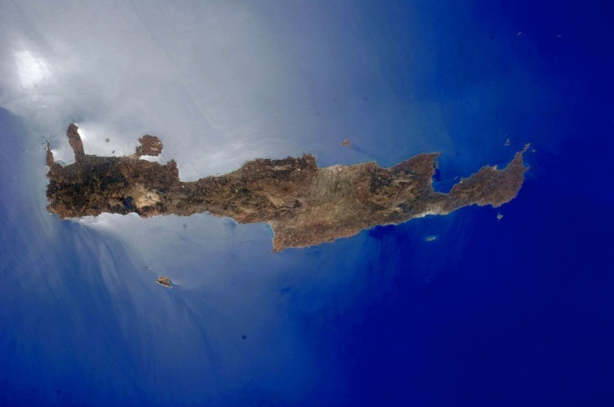
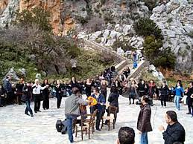
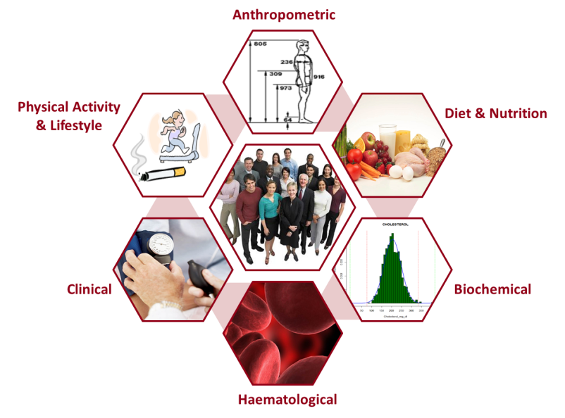
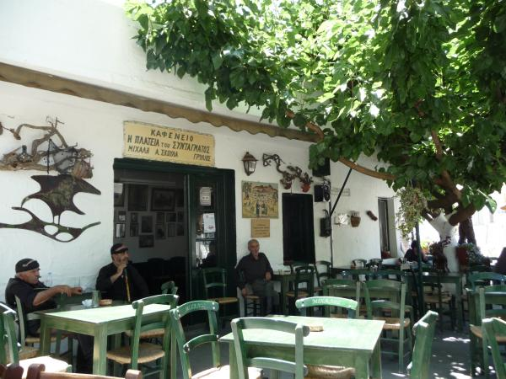
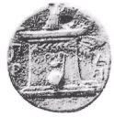
HELIC: Hellenic isolated cohorts
HELIC-MANOLIS (Minoan Isolates)
Mylopotamos villages, Crete, Greece
Geographically isolated
Ancient Dorian dialect
N~4,500 of which 1,800 collected
Deeply phenotyped
High fat content diet
High rates of longevity
Low rates of metabolic disease complications
Ability to recontact individuals
www.helic.org

Slide 41
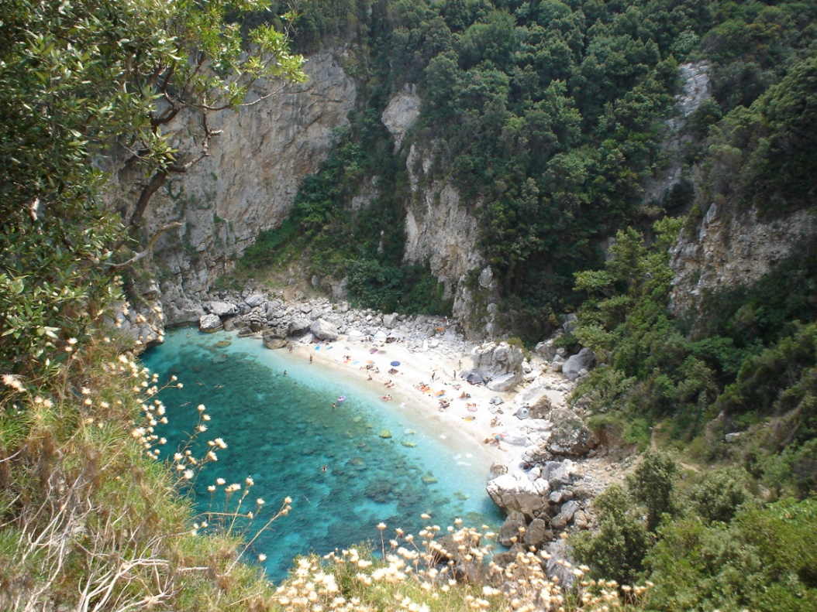

Slide 42
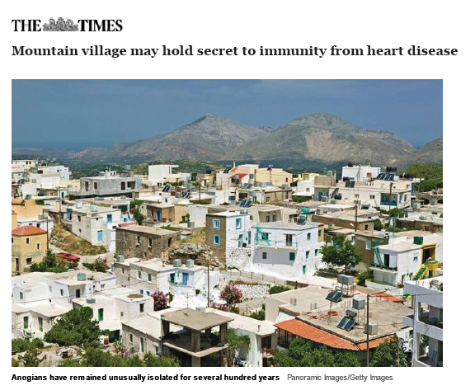
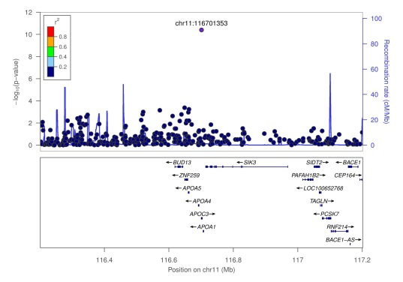

R19X APOC3 cardioprotective variant
Mylopotamos villages (n=1256, MAF 2%, p=10⁻¹¹)
Detection of this effect would have required 67,000 Europeans (MAF 0.05%)

Slide 43


Published GWAS at p≤5X10⁻⁸ for 17 trait categories
NHGRI GWAS Catalog
www.genome.gov/GWAStudies
www.ebi.ac.uk/fgpt/gwas/

Slide 44





Burden of disease in Africa

Slide 45



Large-scale GWAS in a Ugandan cohort
~7000 individuals from the General Population Cohort
2000 with whole genome sequence 4x
5000 with Omni 2.5M genotypes
50 phenotypic traits: hematological, anthropometric, blood pressure, metabolic, liver function and infectious disease traits
Liver enzymes- ALT
GPT gene- produces enzyme
Monomorphic in Europeans
Ugandan frequency: 26%

Slide 46
Genetic architecture of complex traits
Common variants
Rare variants
Small effect size
Large effect size

